Slide 1
OpenHack: Deep Learning
Dave Wentzel
linkedin.com/in/dwentzel
git.davewentzel.com/demos/datasciencehack
Wifi:
Msftguest
Attendee code:

Slide 2
...or...

Slide 3
Building a Neural Network from Scratch
Dave Wentzel
linkedin.com/in/dwentzel
git.davewentzel.com/demos/datasciencehack
Wifi:
Msftguest
Attendee code:

Slide 4
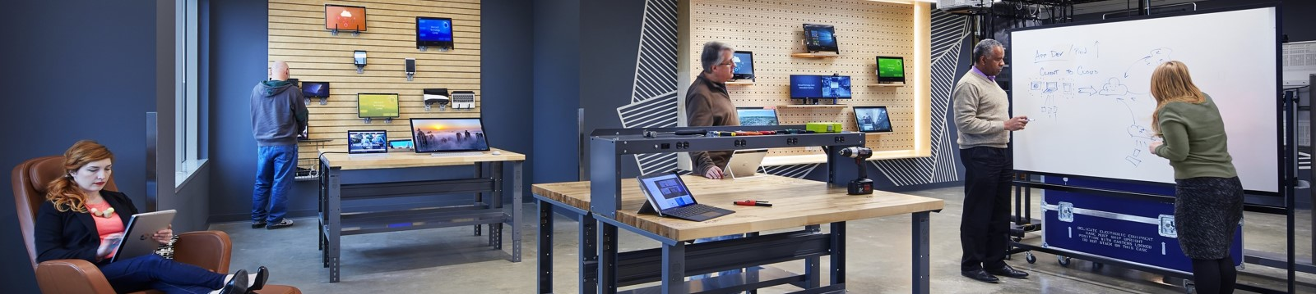
Our Process: Delivering the Right Experiences
Envision what’s possible
Immersive engagements
Aligned solutions
Business outcomes
Engagements
Ideation Session
Explores the impact of digital transformation and innovation to help customers with vision-setting, strategy, roadmaps and organizational alignment.
Strategy Briefing
A strategic business and technical discussion to gain understanding of customer goals and challenges. Align Microsoft capabilities and solutions.
Architecture Design Session
Synthesizes the business and technical requirements for a solution including an initial scope and a high-level architecture to drive next steps.
Hackathon
A hands-on, intensely collaborative and inclusive sprint to determine the applicability of specific technologies against a set of business use cases.
Workshop
A hands-on, immersive education experience to provide the skills and familiarity of a technology to enable solution development and adoption.
Rapid Prototype
A tailored hands-on experience to demonstrate the key technical capabilities of a solution and address any challenges to accelerate decision making.
Notes:
Process: Refined through a decade of delivery, evaluation and improvement, the MTC’s engagement offerings and supporting systems drive decision enablement and actionable next steps for the customer.
Envisioning Experiences
MTC staff will take you through a storyline of business scenarios that map to your business environment. The customized demonstration helps you understand how you can control costs while improving productivity through an optimized IT infrastructure.
Strategy Briefing
A day long engagement that culminates in a vision for how Microsoft and partner technologies can solve your business challenges.
team to find the right solution to meet your exact business needs.
Architecture Design Session
A process to jointly define the architectural vision for a Microsoft-based solution by clarifying the objectives, requirements, and scope.
Immersion Experience
A facilitated, hands-on environment where you can experience the vision of Microsoft’s platform firsthand.
Interactive Experiences
A variety of hands-on device experiences that can be tailored to suit your needs.

Slide 5
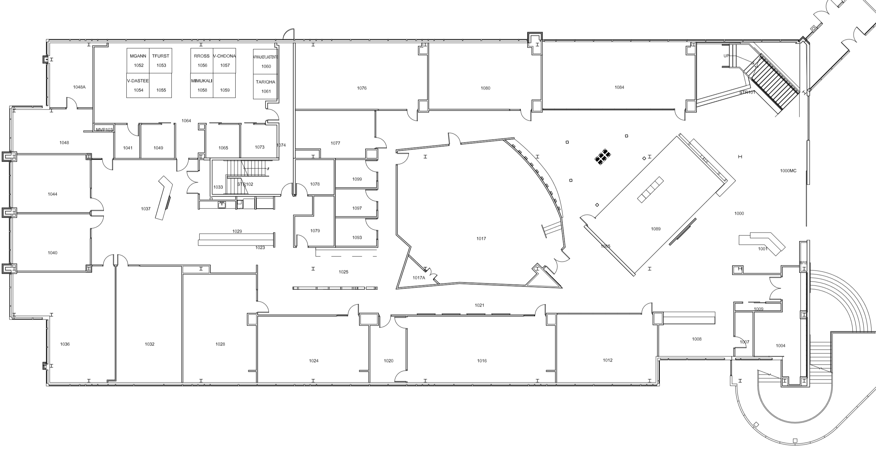
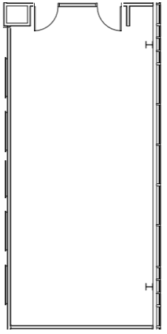
Philadelphia Microsoft Technology Center
EXIT
EXIT
EXIT
ENTRANCE
KITCHEN 1
ENVISIONING
CENTER
RESTROOMS
ELEVATORS
BERWYN
KITCHEN 2
PAOLI
MALVERN

Slide 6
What will I learn?
An intuition into how DL really works
Train a deep learning model for image classification
Use Azure ML to deploy a machine learning model as a web service
Understand neural networks (CNN)
6ish hours of hands-on
but not a “hands-on” lab, it is a CHALLENGE
you won’t finish

Slide 7
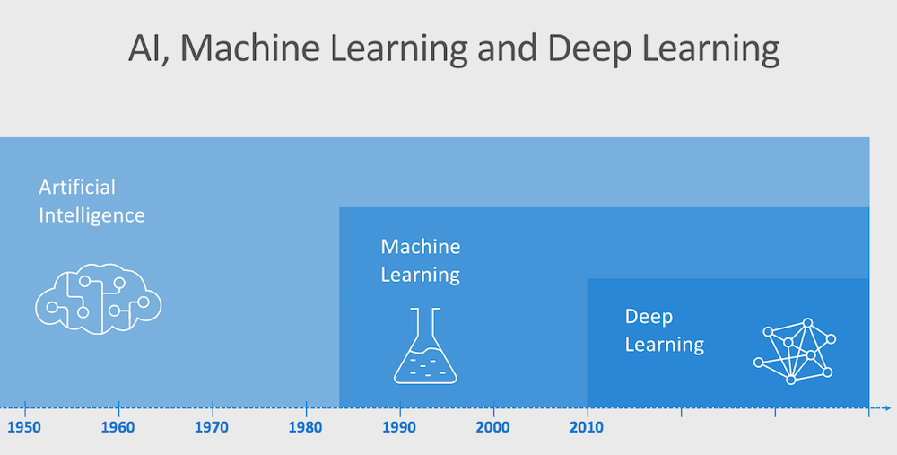
Notes:
Any system that mimics human behavior
Decision trees
Expert systems
Msft definition today
Ai winter due to hype, lack of data and compute
---
Data mining
And lots of data
Math to improve the data
Features and labels
---
Take a stack of algos and apply math
NNs
“layers”

Slide 8
Label
Features
y = f (x )
Notes:
ML is about defining a function that takes input and generates output
lot of math involved, but you don’t need to be a phd
predict the label
assume classification

Slide 9
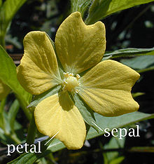
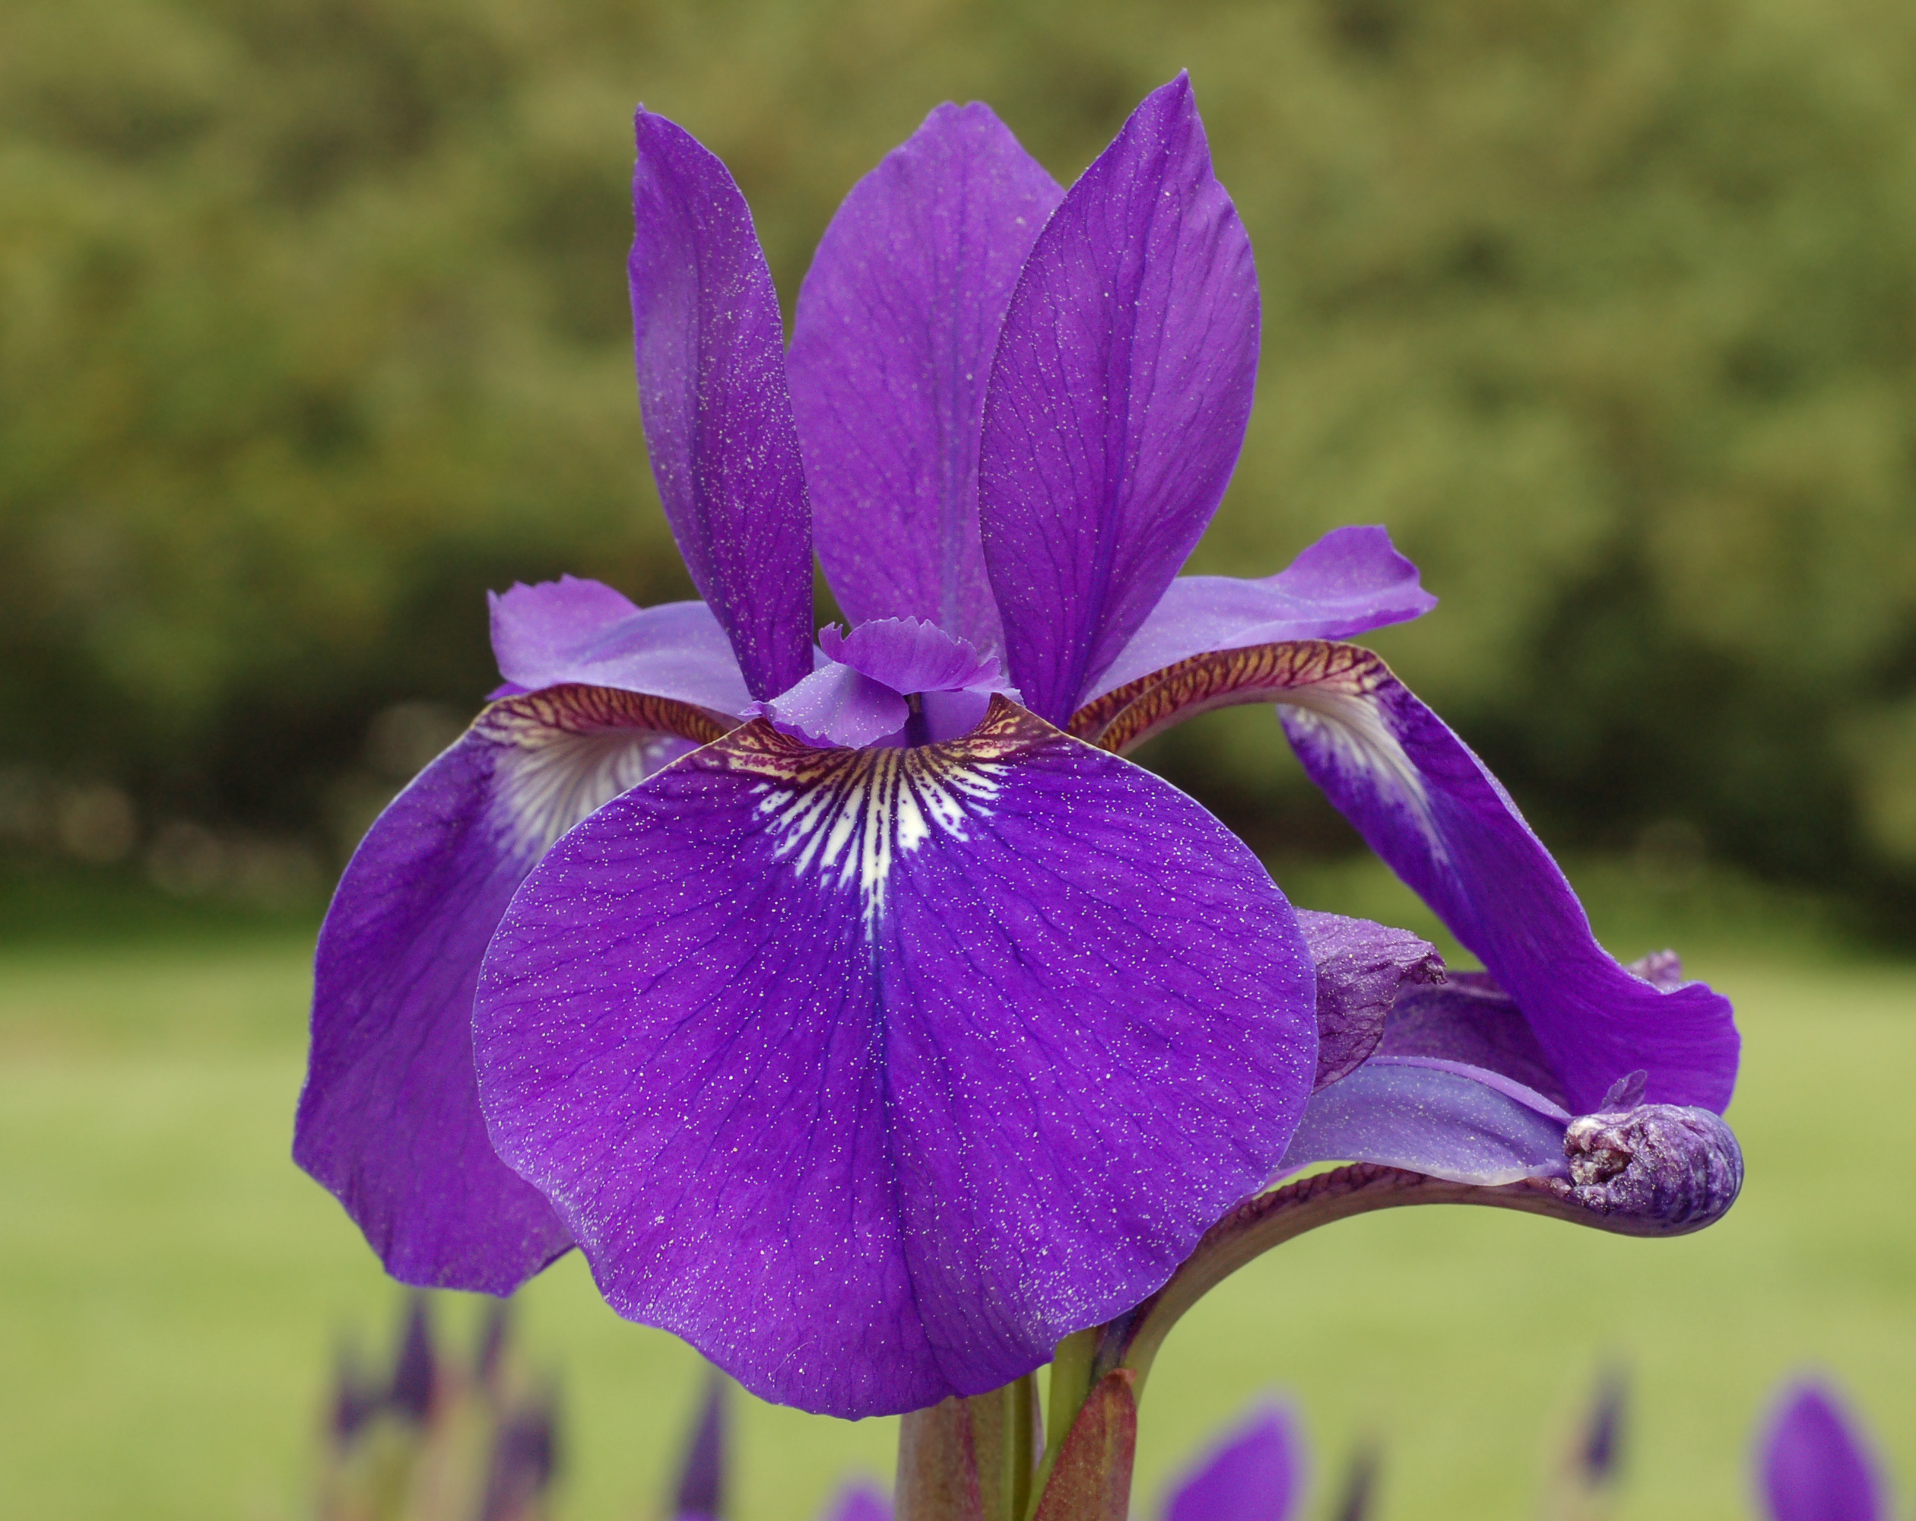
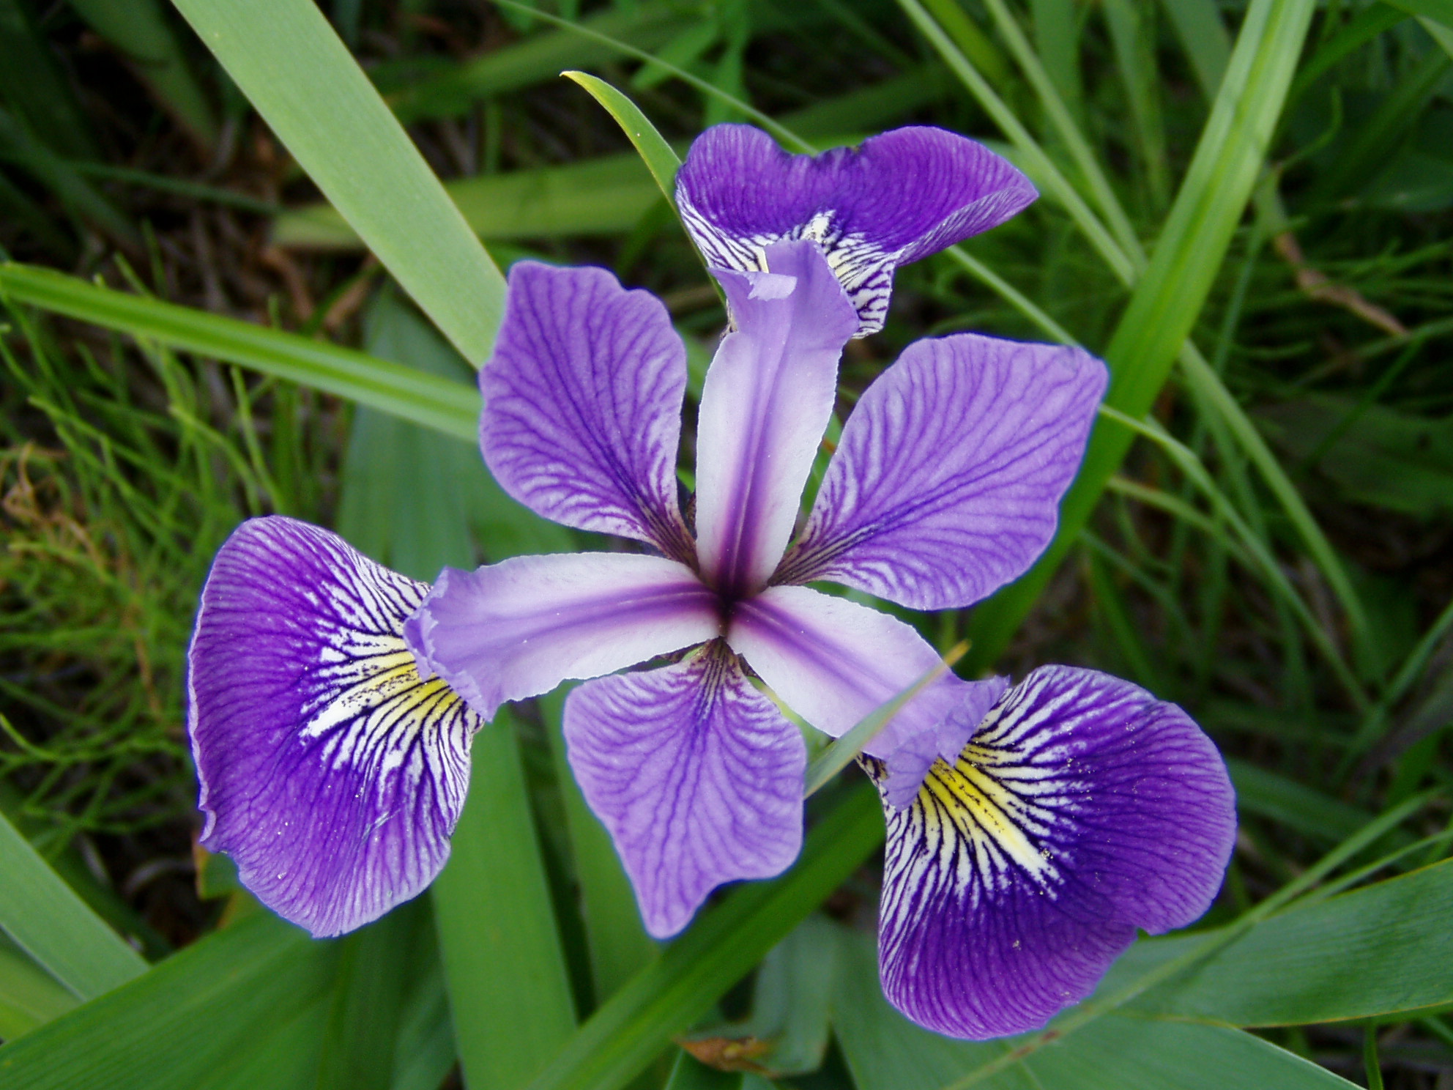
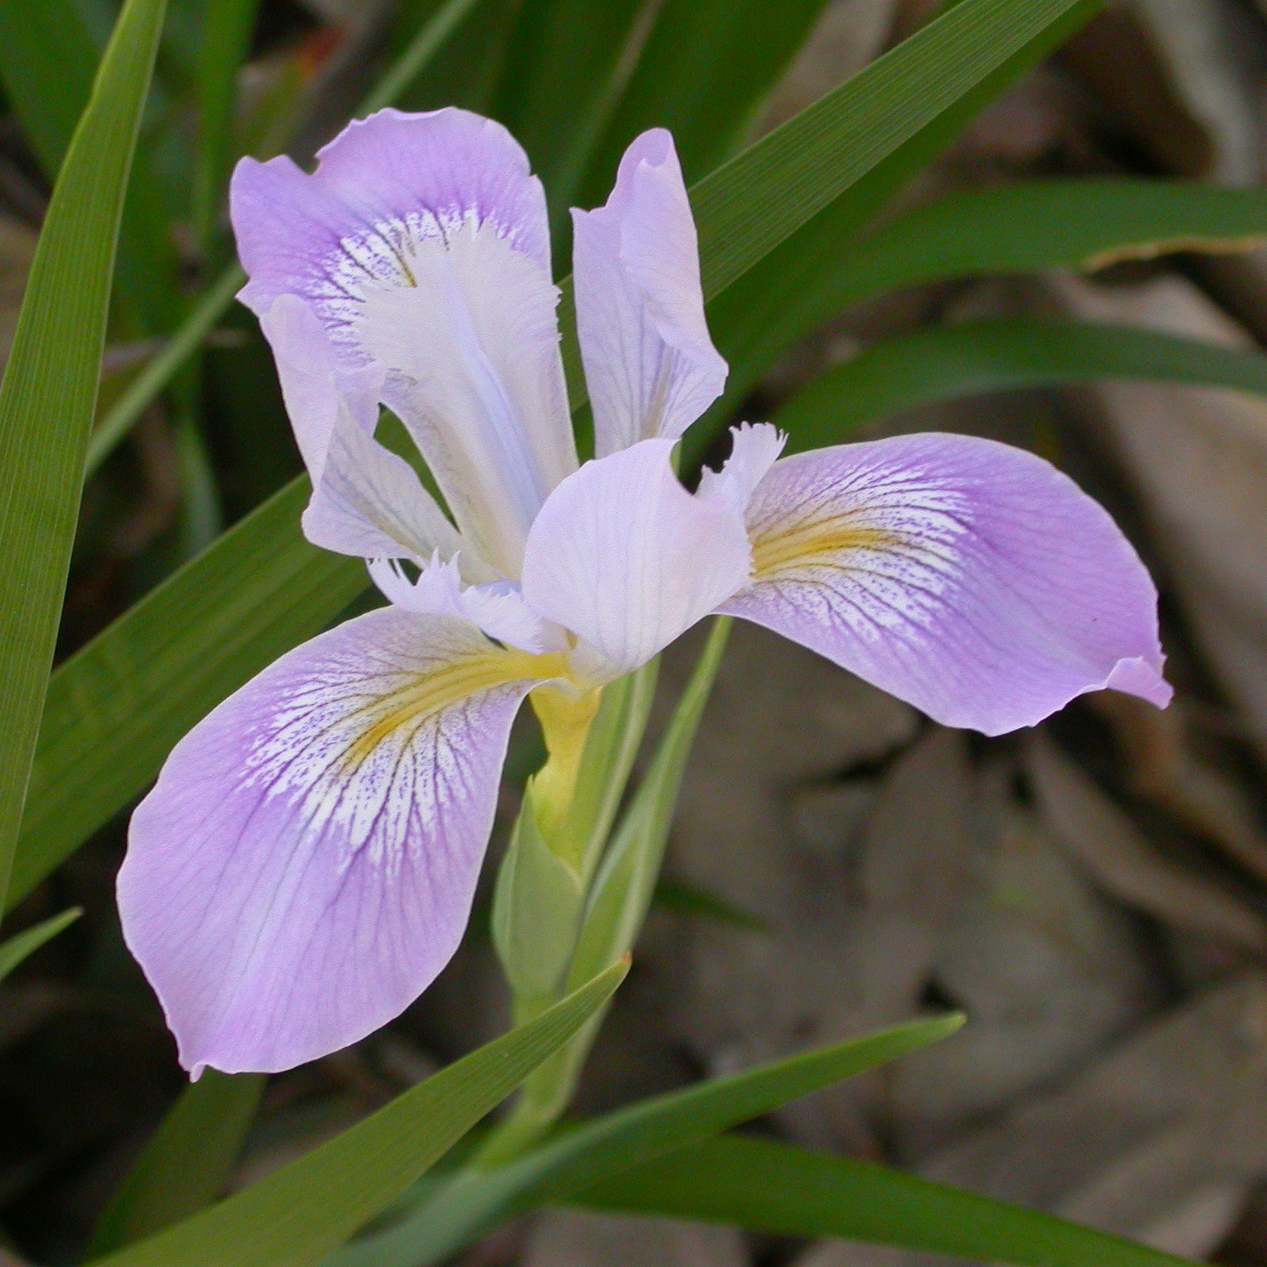
Species
Sepal / Petal Measurements
0 (“Setosa”)
1 (“Versicolor”)
2 (“Virginica”)
[6.6, 3.2, 5.8, 2.4]
y = f (x )
= [0, 1, 0]
Notes:
iris classification data: hello world of ML
3 different species of irises
x is a vector of multiple values (length, width, etc)
y is a vector.
The output is the probabilities of the classes
we know the inputs, but what is f?
this is “traditional ML”

Slide 10
b
w₁
x₁
y
∫
( )
f (x,w )
f (x,w,b )
x₂
∑
(xxw)+b
w₂
Notes:
but DL may be better, modeled on human brain
neuron
some inputs get stronger or weaker as we learn over time (weights)
when so many fire it gets passed to the next neuron
we want to control the firing a bit more so we add a bias
(weighted sum of each x/w pair)
the activation function (sigmoid) squashes the output between 0 and 1

Slide 11
Neural Network (Perceptron)
6.6
3.2
5.8
2.4
∫∑(xw)+b
0.3
∫∑(xw)+b
∫∑(xw)+b
0.4
= [0.3, 0.4, 0.3]
∫∑(xw)+b
∫∑(xw)+b
[0.0, 1.0, 0.0]
0.3
∫∑(xw)+b
∫∑(xw)+b
Loss = 0.16
Loss = μ(0.3, 0.6, 0.3)²
Notes:
vector of lengths and widths
neurons and randomly assigned weights
outputs are passed forward to another layer of neurons
fully connected network
output is always the number of classes
the loss function calculates the distance from the answer.
find the difference, then the mean, then square it
loss tells you how far from truth
this creates nested functions
function within a function, within a function

Slide 12
1
Loss
0
1
2
3
w₁
Notes:
the loss can be graphed and the weight modified with calculus
this is the “gradient”.
which way do I adjust the weight so the loss goes down

Slide 13
Loss
Notes:
this is a RGB example
in which direction do I adjust params so the loss goes down

Slide 14
Backpropagation
6.6
3.2
5.8
2.4
∫∑(xw)+b
∫∑(xw)+b
0.2
0.3
∫∑(xw)+b
∫∑(xw)+b
∫∑(xw)+b
∫∑(xw)+b
= [0.3, 0.4, 0.3]
0.7
= [0.2, 0.7, 0.1]
∫∑(xw)+b
0.4
∫∑(xw)+b
∫∑(xw)+b
[0.0, 1.0, 0.0]
∫∑(xw)+b
0.1
0.3
∫∑(xw)+b
∫∑(xw)+b
∫∑(xw)+b
∫∑(xw)+b
Loss = μ(0.2, 0.3, 0.1)²
Loss = 0.04
Notes:
we feed that back into the network and recalc
new weights and biases should get you closer to the truth
epochs

Slide 15
Training
Backpropagation
Validation
5.2
1.2
4.7
2.1
6.6
3.2
5.8
2.4
6.1
2.4
4.6
1.9
2.1
0.8
7.1
2.3
∫∑(xw)+b
∫∑(xw)+b
0.1
0.2
0.0
0.6
0.0
0.0
0.8
0.1
∫∑(xw)+b
∫∑(xw)+b
∫∑(xw)+b
∫∑(xw)+b
Loss = μ([c₁, c₂, c₃,…])²
0.0
0.7
1.0
0.2
0.0
0.1
∫∑(xw)+b
0.1
0.0
∫∑(xw)+b
∫∑(xw)+b

∫∑(xw)+b
0.0
0.1
0.0
0.2
1.0
0.9
0.1
0.0
∫∑(xw)+b
∫∑(xw)+b
∫∑(xw)+b
∫∑(xw)+b
Notes:
calculate overall loss.
now take the holdout set and validate

Slide 16
x
w
b
6.6
3.2
5.8
2.4
6.1
2.4
4.6
1.9
2.1
0.8
7.1
2.3
0.6
0.3
0.4
0.9
0.1
0.2
0.1
0.3
x
+
Notes:
i lied
in reality we don’t send one iris at a time
mini-batch
we arrange the values as a vector, then as a matrix
then w and b as vectors
now we can do linear algebra
this is why we use GPUs. graphical games are just matrices and vectors
this is a neural network or a perceptron

Slide 17
0 | 0 | 0 | 0 | 0 | 0
0 | 3 | 2 | 2 | 3 | 0
0 | 0 | 2 | 2 | 0 | 0
0 | 0 | 2 | 2 | 0 | 0
0 | 3 | 2 | 2 | 3 | 0
0 | 0 | 0 | 0 | 0 | 0
∫∑(xw)+b
0 | 0 | 0 | 0 | 0 | 0
0 | 3 | 2 | 2 | 3 | 0
0 | 0 | 2 | 2 | 0 | 0
0 | 0 | 2 | 2 | 0 | 0
0 | 3 | 2 | 2 | 3 | 0
0 | 0 | 0 | 0 | 0 | 0
0 | 0 | 0 | 0 | 0 | 0
0 | 3 | 2 | 2 | 3 | 0
0 | 0 | 2 | 2 | 0 | 0
0 | 0 | 2 | 2 | 0 | 0
0 | 3 | 2 | 2 | 3 | 0
0 | 0 | 0 | 0 | 0 | 0
1.0
0 | 0 | 0 | 0 | 0 | 0
0 | 3 | 2 | 2 | 3 | 0
0 | 0 | 2 | 2 | 0 | 0
0 | 0 | 2 | 2 | 0 | 0
0 | 3 | 2 | 2 | 3 | 0
0 | 0 | 0 | 0 | 0 | 0
∫∑(xw)+b
∫∑(xw)+b
0.0
∫∑(xw)+b
∫∑(xw)+b
0.0
∫∑(xw)+b
∫∑(xw)+b
Notes:
how is this applied to images?
array of RGBs
this can be fed into a perceptron, but not great
much of the data isn’t valuable
it’s much better to extract the features myself

Slide 18
Convolution
0 | 0 | 0 | 0 | 0 | 0
0 | 3 | 2 | 2 | 3 | 0
0 | 0 | 2 | 2 | 0 | 0
0 | 0 | 2 | 2 | 0 | 0
0 | 3 | 2 | 2 | 3 | 0
0 | 0 | 0 | 0 | 0 | 0
1 | 0 | 0
0 | 1 | 0
0 | 0 | 1
5
4
4
3
2
7
4
2
2
4
7
2
3
2
4
5
Notes:
take the numbers that are valuable
pixel intensity (b/w image)
create a filter (smaller than what I’m working with), assigned randomly
called the kernel (kernel=3)
generate a feature map
do multiplication, then add
“convolve” the image
but we still have the same number of values

Slide 19
Pooling (Downsampling)
0 | 0 | 0 | 0 | 0 | 0
0 | 5 | 4 | 4 | 3 | 0
0 | 2 | 7 | 4 | 2 | 0
0 | 2 | 4 | 7 | 2 | 0
0 | 3 | 2 | 4 | 5 | 0
0 | 0 | 0 | 0 | 0 | 0
7 | 7 | 7 | 4
7 | 7 | 7 | 7
7 | 7 | 7 | 7
4 | 7 | 7 | 7
7 | 7 | 7 | 4
7 | 7 | 7 | 7
7 | 7 | 7 | 7
4 | 7 | 7 | 7
7
Notes:
output is something that looks like this
take the max value of each square and convolve
this exaggerates the feature
we have summarized a larger matrix to a smaller one

Slide 20
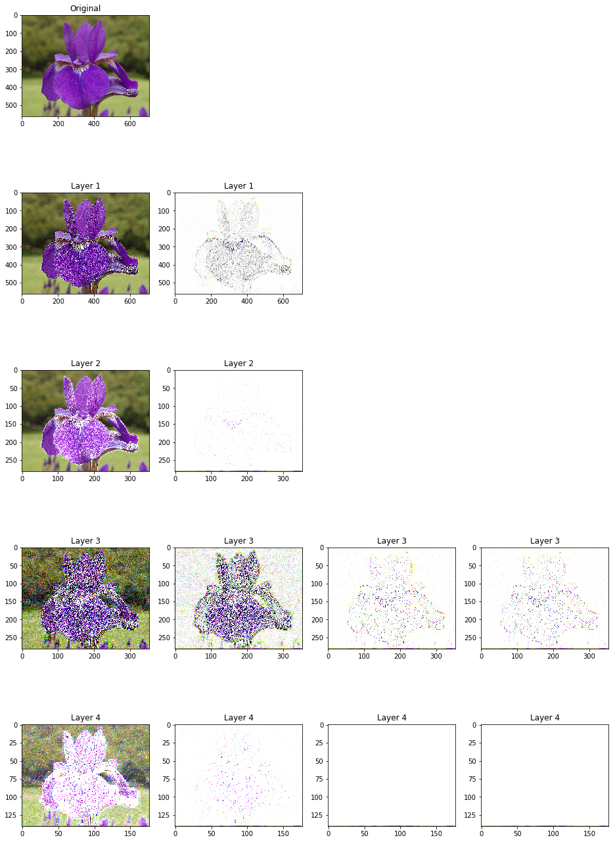
Convolutional Neural Network
0
0
0
0
3
2
0
0
2
∫∑(xw)+b
∫∑(xw)+b
0.8
0 | 0 | 0
0 | 3 | 2
0 | 0 | 2
∫∑(xw)+b
∫∑(xw)+b
0.2
0
0
0
0
3
2
0
0
2
∫∑(xw)+b
∫∑(xw)+b
0.0
0 | 0 | 0
0 | 3 | 2
0 | 0 | 2
∫∑(xw)+b
= [0.8, 0.2, 0.0]
Feature Extraction
Classification
Notes:
in action
2 different filters
then downsample
we may choose to randomly drop things to avoid overfitting
features are outputted and flattened
notebooks.azure.com
corp
CNNTutorial
02-image-classification
now do Azure Cognitive Services

Slide 21

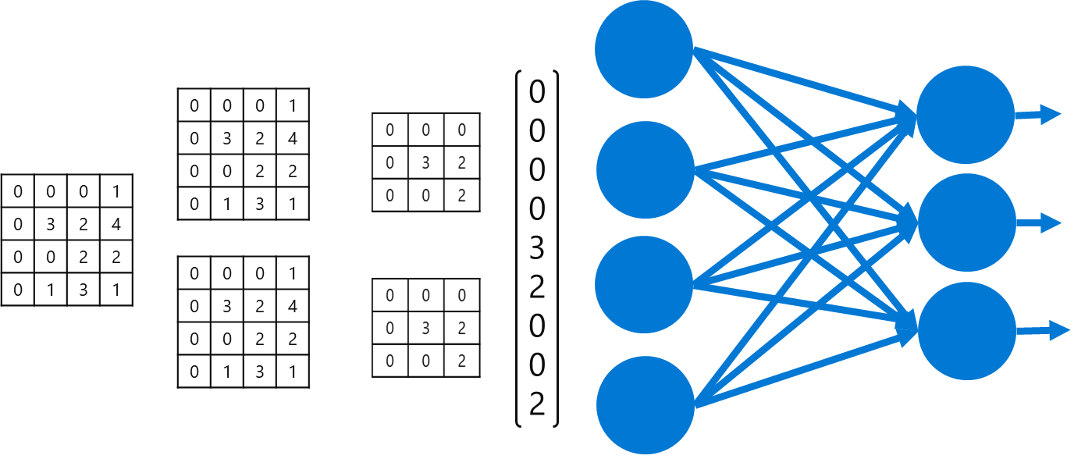

?
Setosa
Notes:
once we have a model we save it
sometimes save the weights separately
put it in a repo/amls
define a compute image to use that model
service uses the container to inference

Slide 22
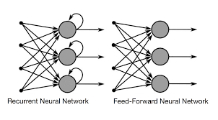
Recurrent Neural Network
share parameters around a “time” dimension vs a CNN which shares parameters around a 2D spatial dimension
“recurrent” = “recursive”
parameters are “back-fed” (like a loop) with previous values. This is also called backpropogation but it is NOT the same as CNN backpropogation

Slide 23
Recurrent Neural Network
Over time you run into gradient problems when you backpropogate as you continue to add the same weights and biases. Using a forget gate allows you to "forget" some of that information.
This is an LSTM (Long Short-term Memory) as we know it today.
Common Use Cases:
IoT
time-series analytics
anomaly detection/alerting
some NLP problems
conversational bots
Notes:
demo:
notebooks.azure.com
personal
RNN_IoT
Lab 5

